Slide 1



Brandon
Moore
Co-Owner: Adilas, LLC
Web: adilas.biz
Email: brandon@adilas.biz
Cell: 435.881.1536

Slide 2
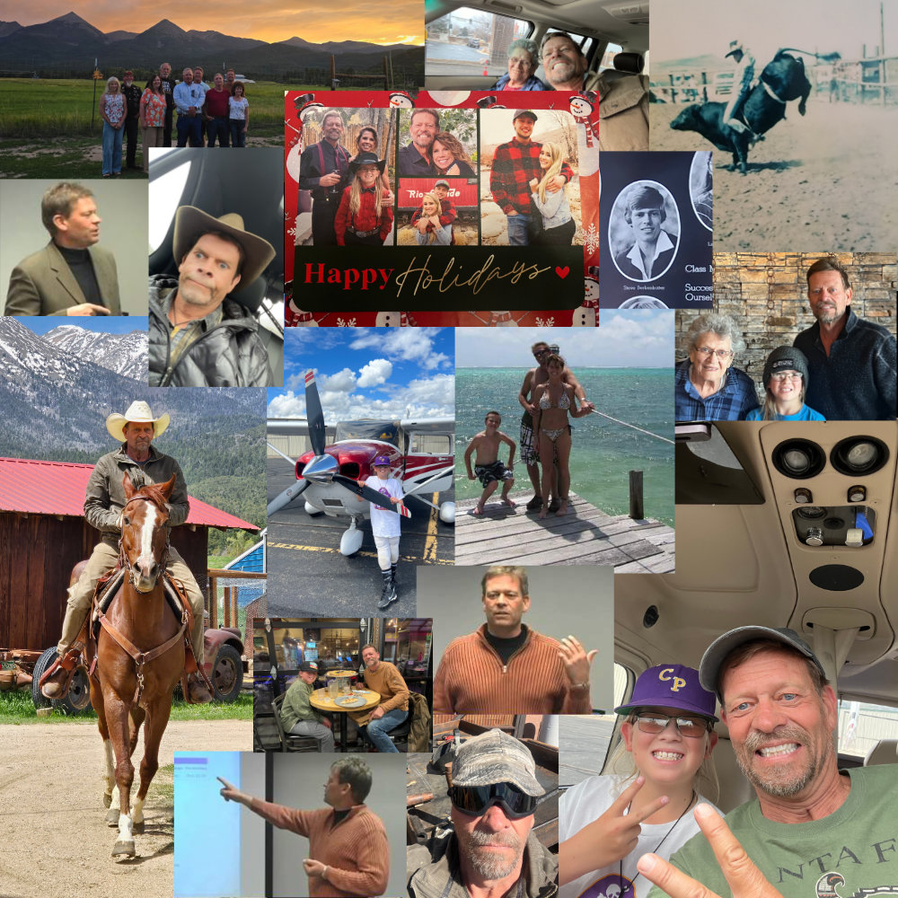
Steve
Berkenkotter
Co-Owner: Adilas, LLC
Web: adilas.biz
Email: steve@adilas.biz
Cell: 719.439.1761

Slide 3
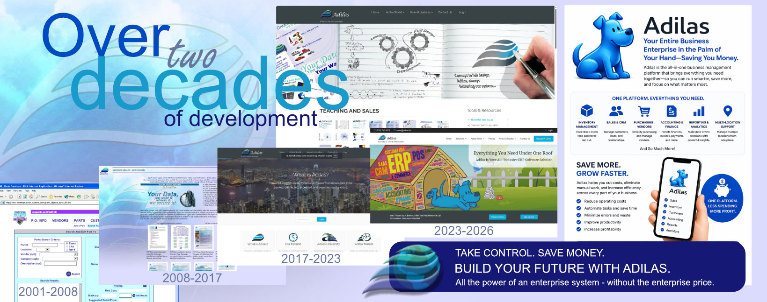

Slide 4
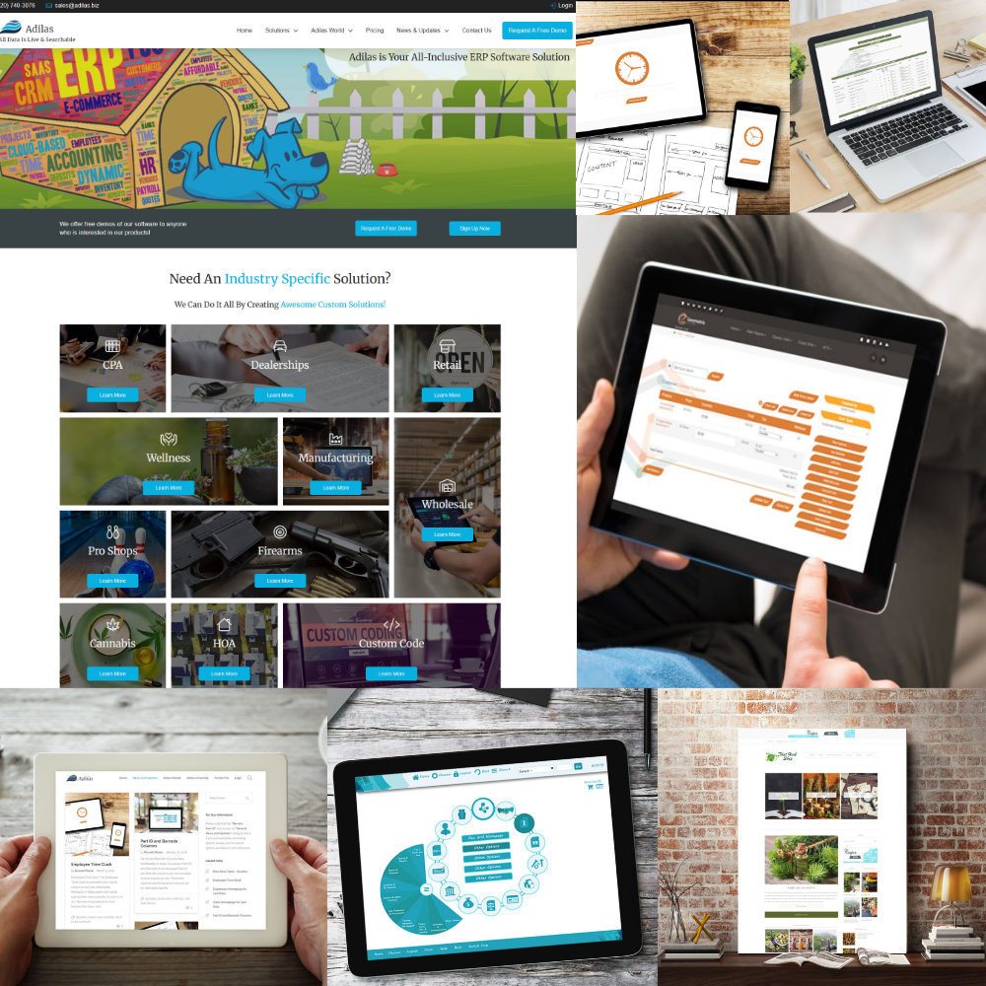
What Do
We Offer?
Online SaaS
Software as a Service
Operations
Accounting
Standard Package
Custom Code
Start Small → Expand
Great Pricing

Slide 5
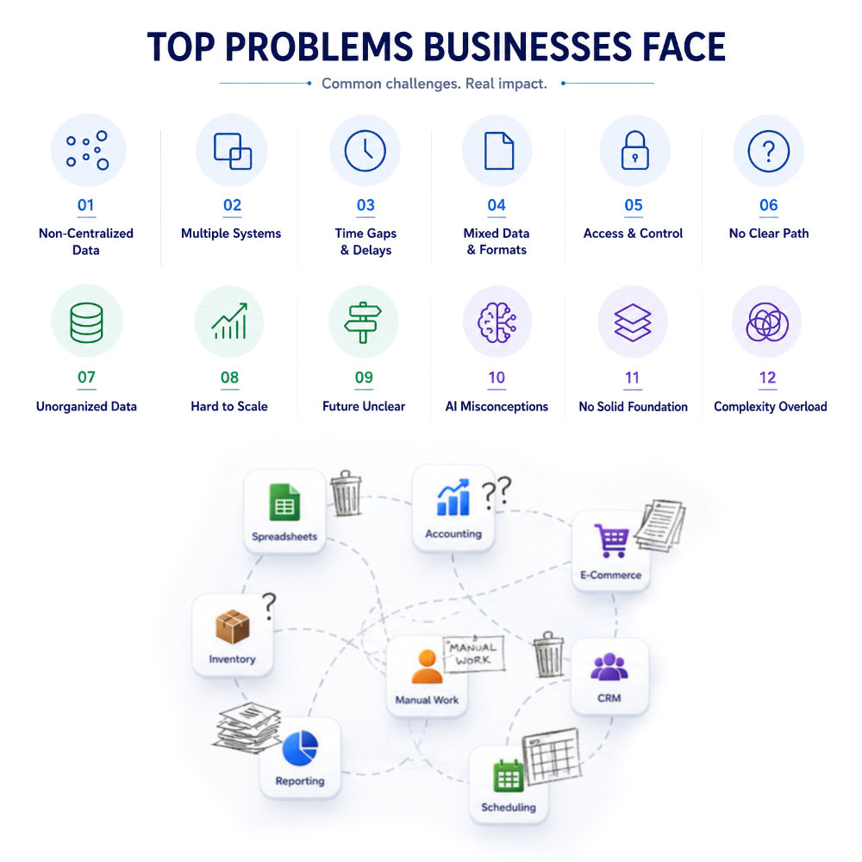
Common
Practices
Disconnected Systems
Data All Over The Place
Batching & Time Gaps
Dead Ends
Duplicate Data
Legacy Systems
Manual Processes
Hopefully Gets United??

Slide 6
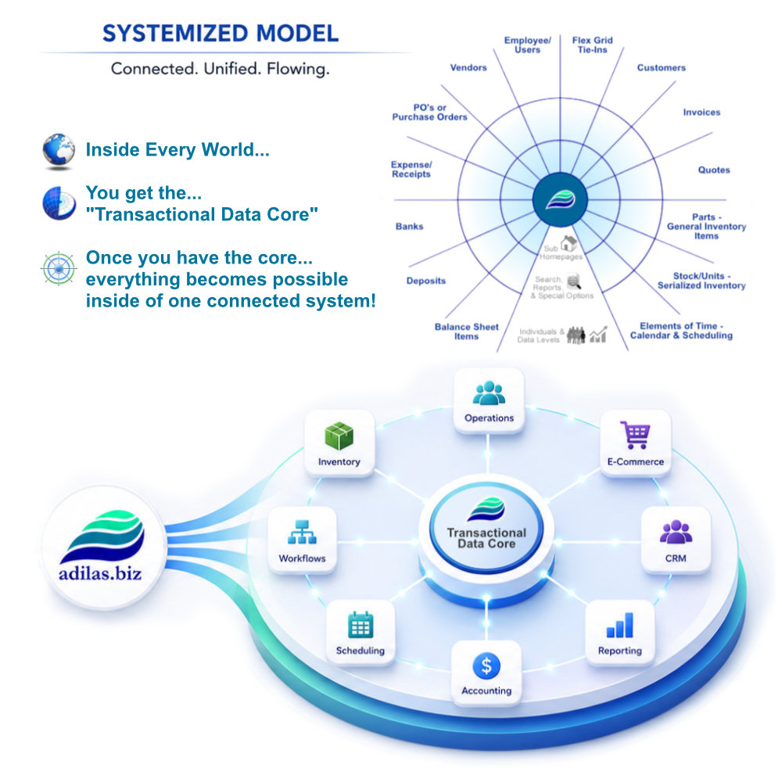
How Adilas
Works!
Kick-butt Data Engine
Interconnected Pieces
Relationships
Business Logic
Transactional Data Core
Configurable
Expandable
You Get It All!

Slide 7
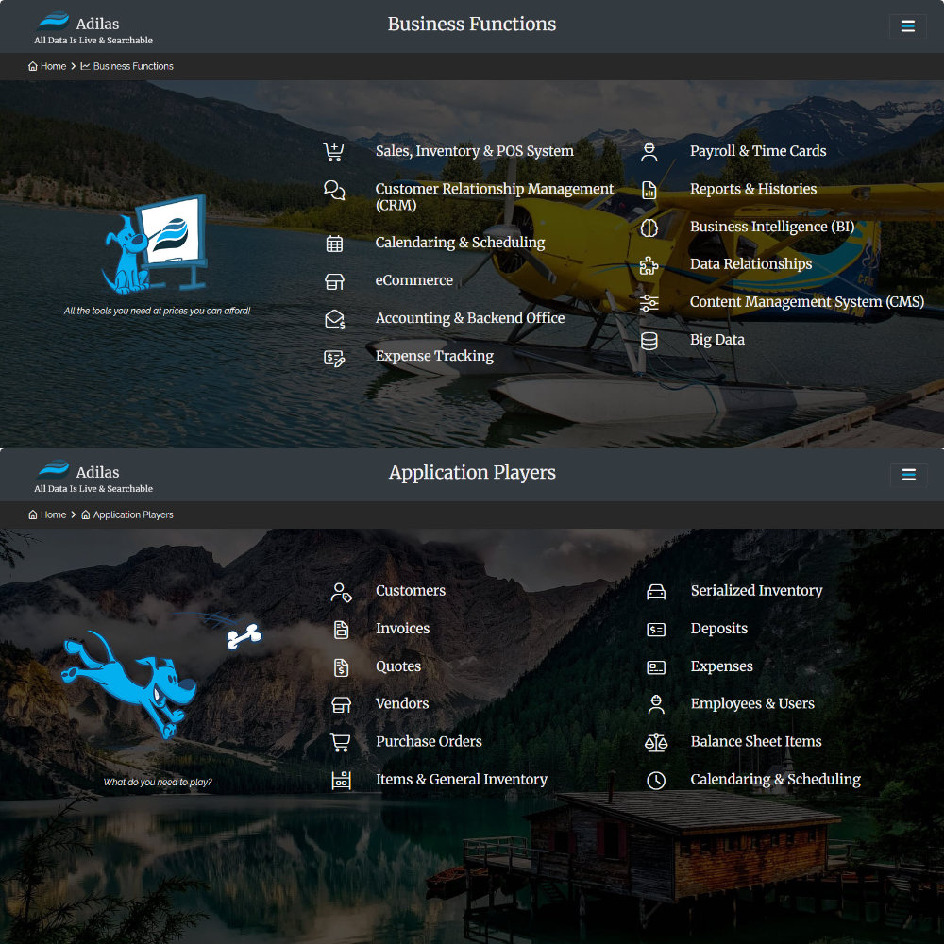
Functions &
Players
POS, CRM, ERP,
Inventory Tracking,
eCommerce,
Scheduling,
Accounting,
and so much more.
Use Players to get
Business Functions

Slide 8
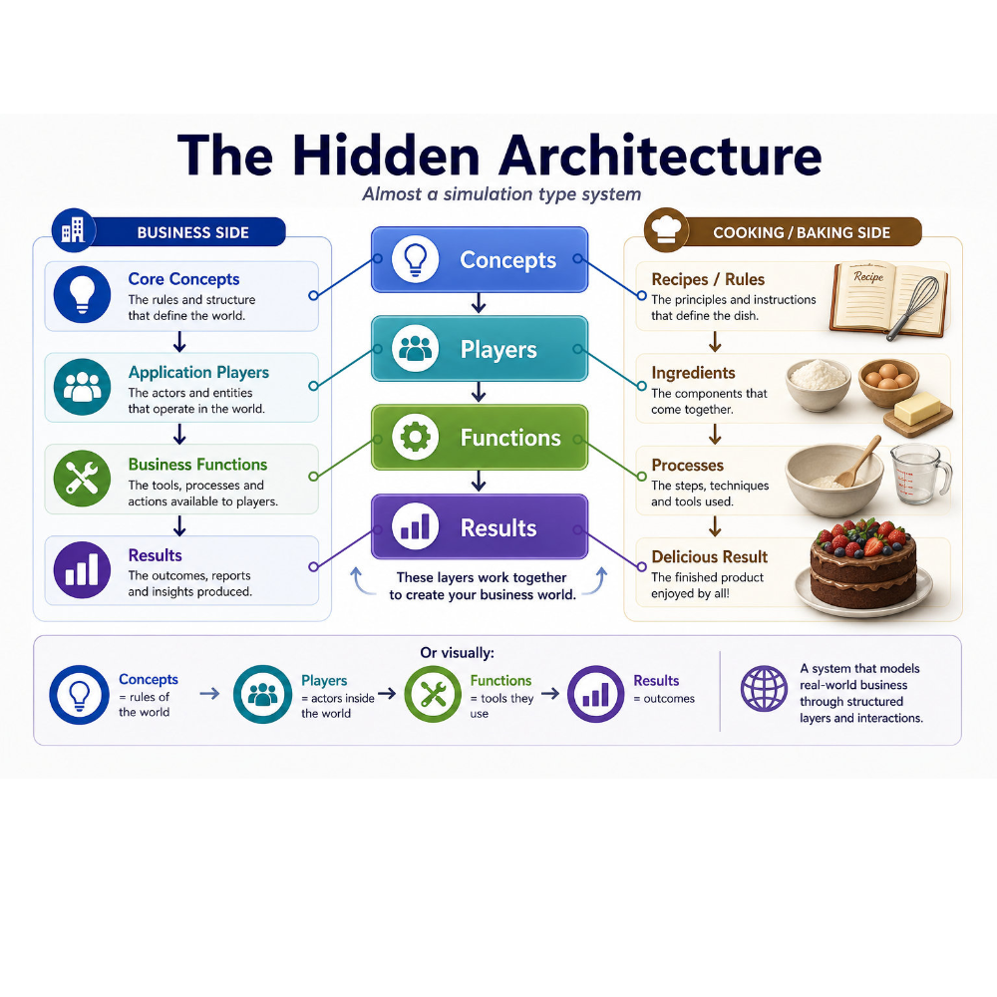
Concepts &
Recipes
To get results, you have
to start mixing.
Use Players
Mix Functions
Apply Concepts
Create Results

Slide 9

Desired
Outcomes
Operational Control
Customer Awareness
Financial Visibility
Process Efficiency
Business Intelligence
Strategic Insight
Accountability
Revenue Expansion

Slide 10
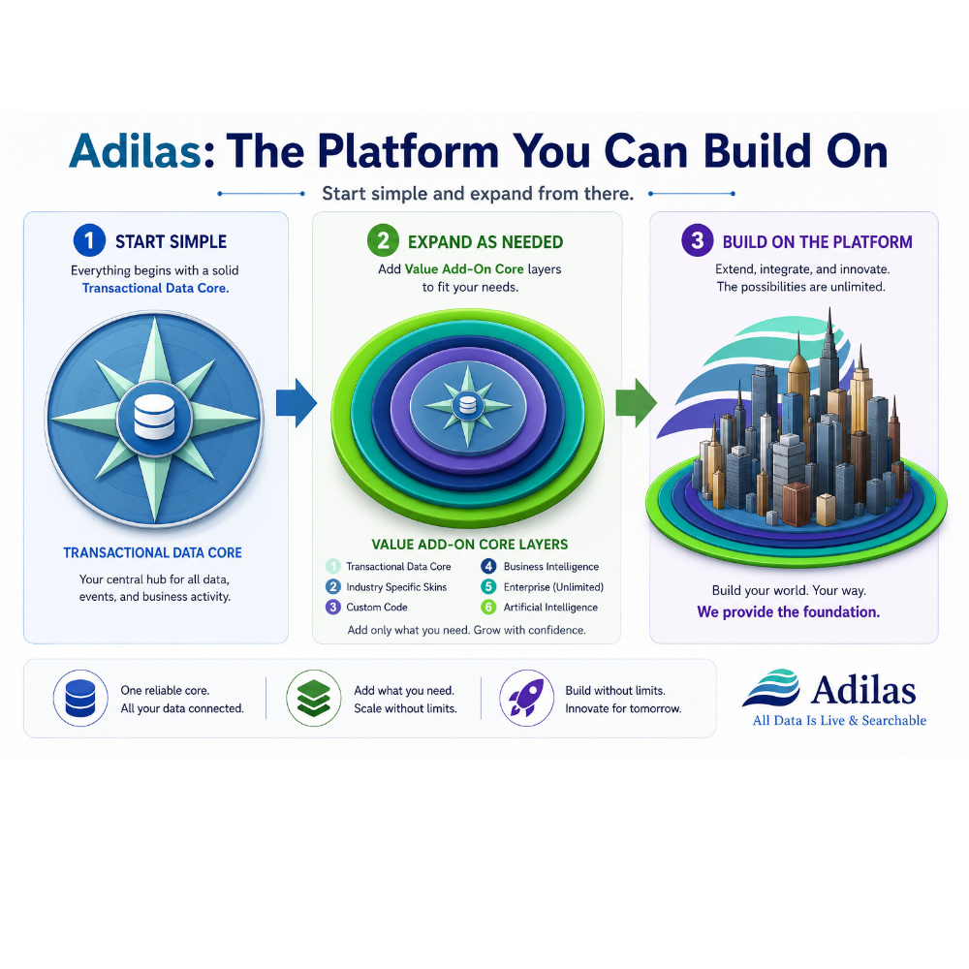
Looking
Ahead…
Connected
Intelligent
Conversational
Automated
Community Driven
Platform Refinement
Ecosystem Growth
World Building

Slide 11
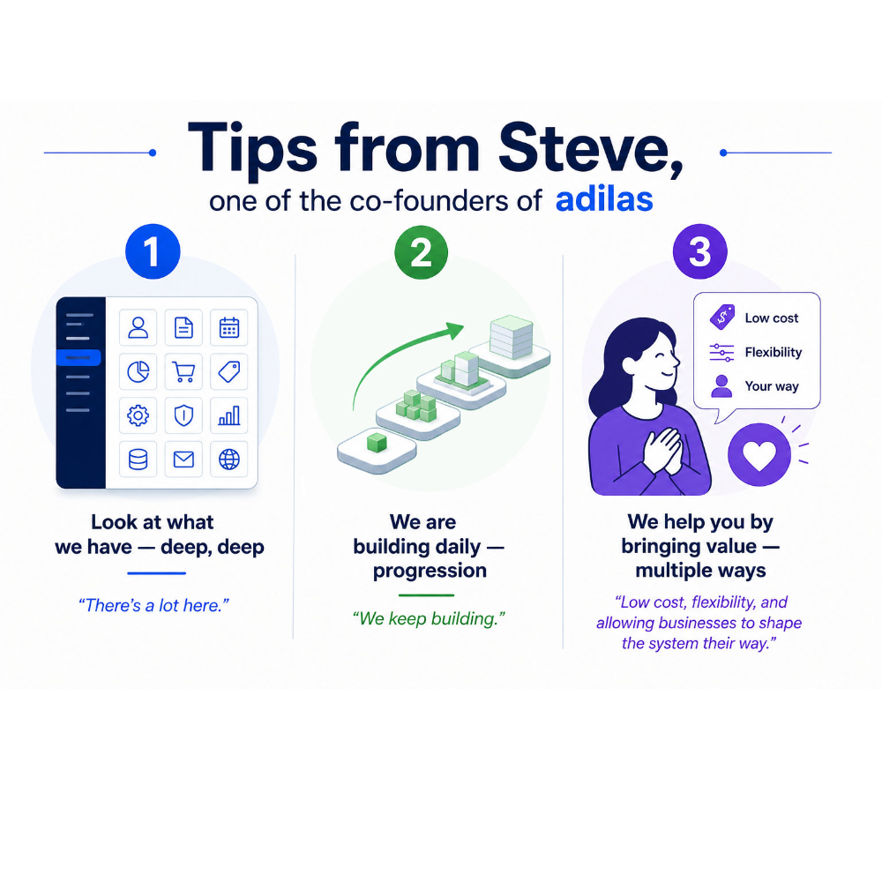
Thank You!
To Learn More…
Explore The Platform
Participate
Contribute
Partner
Invest
Follow The Journey
Visit: adilas.biz
Questions:
Text Brandon – 435.881.1536
Text Steve – 719.439.1761

